Slide 1
Language assessments: Tools for English teaching excellence”
November 2023

Slide 2
Today’s session
Defining assessment
What do we assess?
Communicative competence and language ability – what is it?
How do we assess language ability and communicative competence
Aligning assessment to learning
Types of assessment
Types of test
What defines a quality test.
Notes:
Quick outline of first part of talk.
First we will offer a definition of assessment in the context of language teaching.
Then examine what communicative competence and language ability is (need to understand what it is before we assess it)
Then focus on how we assess language ability and the importance of aligning assessment to what learners learn
We will then focus on types of assessment
And end by focusing on what we understand defines quality in test development

Slide 3
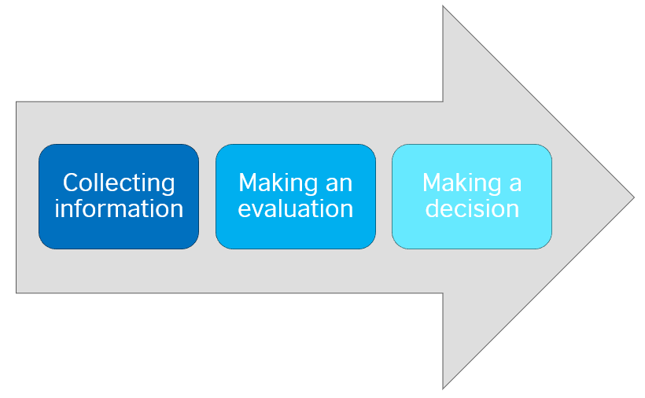
A definition of assessment
In the context of language teaching and learning, 'assessment' refers to the act of collecting information and making judgments about a language learner's knowledge of a language and ability to use it.
(Carol Chapelle and Geoff Brindley)
Notes:
Definition of assessment Carol Chapelle and Geoff Brindley - Universities of Iowa State and Macquarie

Slide 4


Understanding language ability
Notes:
What skills and competences are involved in language ability or language proficiency?
Grammar and vocabulary is one aspect of language proficiency, but what else? The definition of assessment we have just seen is an indicator. Language proficiency encompasses both language KNOWLEDGE (left) and language IN USE (right).

Slide 5
Communicative competence / language ability
Linguistic competence
Strategic competence
Communicative competence
Socio-linguistic competence
Discourse competence
Notes:
Communicative competence and language ability – what is it? This is an important question as we need to understand what it is before we assess it.
Current thinking suggests that there are 4 broad competences that contribute to communicative competence, in other words language ability.
The most obvious competence is linguistic competence; grammar, vocabulary, spelling , punctuation, etc.
Of course, we need all these linguistic elements in language BUT linguistic competence is not sufficient to be able to use language effectively to perform tasks in the real world. Knowing the difference between present simple and present perfect does not mean you can pick up the phone and respond to a question about something that happened yesterday or last week.
Language assessment therefore should NOT just include linguistic elements as this would have a washback effect on what is being taught in the class and focusing only on linguistic elements is NOT going to ensure learners can use language outside the class.
The other competences need to be considered; Socio –linguistic competence, Discourse competence, and strategic competence.

Slide 6
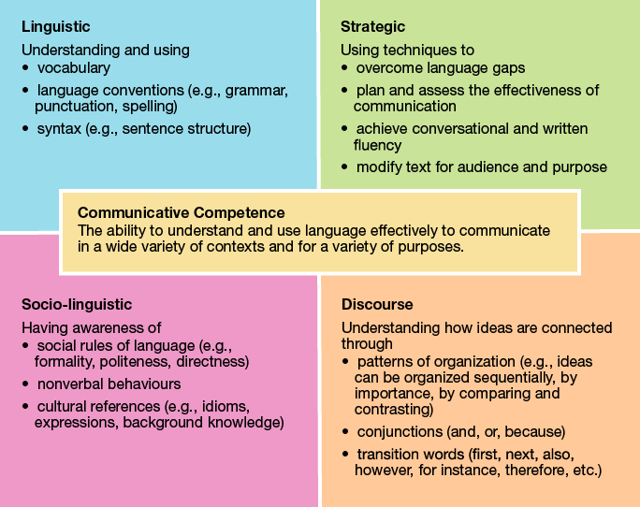
Communicative competence explained
Notes:
As I’ve just mentioned, linguistic competence encompasses knowledge of and use of vocabulary, grammar, spelling , punctuation and syntax.
2. Socio –linguistic competence, on the other hand involves understanding how we adapt language to meet our needs and our understanding of politeness conventions, cultural norms etc. For example, if I want to borrow 20€ from my mum the language I will use will be different to the language I would use when negotiating a loan from a bank.
3. Discourse competence refers to the ability to structure speech and writing coherently and cohesively so that the listener or reader can follow the message you want to communicate, For example, through signposting; sentence connectors , giving examples, clarifications when speaking over a long turn, as I am doing now.
4. Finally, we have strategic competence, which involves the ability to KEEP GOING despite gaps you may have in vocabulary and language knowledge, to prevent communication breakdown. For example, with the use of paraphrasing to help maintain FLUENCY.
In order to improve learners’ language ability across communicative competencies, rather than just their knowledge of grammar and vocabulary, we need to focus on teaching communicative competence, and when we assess their progress in language learning, we therefore need to assess their communicative competencies.

Slide 7
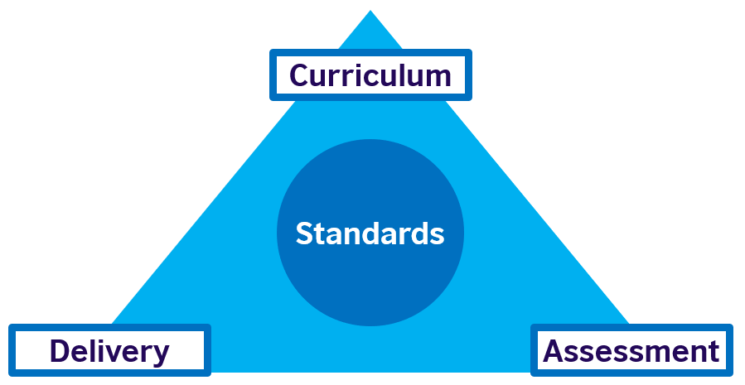
Comprehensive Learning System (O’Sullivan 2020)
Aligning assessment to learning
What learning goals need to be achieved?
What needs to be learnt?
Have the learning goals been achieved?
What gaps should be focused on to achieve these goals?
How will these learning goals be achieved?
Notes:
For a language learning programme that focuses on improving language ability across the communicative competencies to function efficiently, the curriculum – the learning goals and what needs to be learnt to achieve those goals – and assessment need to be aligned. In other words what is assessed is what the learners have learnt in the curriculum. How the curriculum is delivered – who teaches, the resources used to teach, and the physical learning environment also need to be aligned.

Slide 8
Comprehensive Learning System (O’Sullivan 2020)
Communicative competence
Focus – effective communication across skills
Classroom practice and resources
reflect the curriculum
Assessment aligned to curriculum and delivery
Notes:
As you can see here – go through points

Slide 9
Types of assessment
Formative
Before or during the learning process
Help learners learn
Identify areas for improvement
Informs teaching based on learner
needs
Summative
Assesses learner performance
At the end of learning period
Collects evidence of learner knowledge and proficiency
Generally linked to a grade/score
Placement
Notes:
Discounting placement testing, assessment of language learning can be classified as either formative – taking place during the learning process or summative – assessing the learener at the end of the learning period.

Slide 10
Types of assessment
Formative
When
the
cook
tastes
the
soup
Summative
When
the
customer
tastes
the
soup
Notes:
Use metaphor

Slide 11
Types of assessment
Formative
Observations
Classwork
Homework
Quizzes
Q & A
Progress tests
Peer assessment
Summative
Year-end assessment
Course portfolio
Mid-term exam
Proficiency test
Formal exam
Course project
Standards-based test
Both assess
Both can provide feedback
Notes:
Examples of both formative and summative assessments – mention that tests are a form of assessment, but assessment is not always a test - see examples

Slide 12
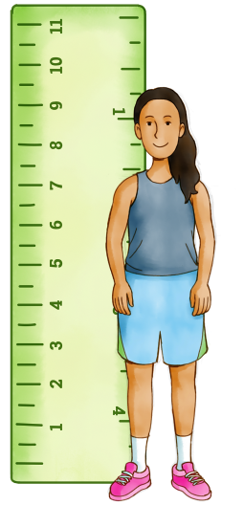
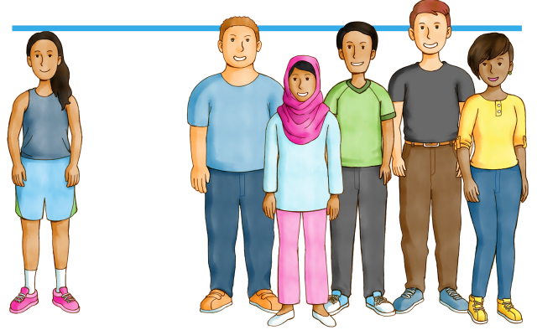








Test types: Focus
Norm referenced Criterion referenced
Direct Indirect Semi-direct
Discrete Integrative
Notes:
Look at types of test – defined either in terms of focus, delivery or scoring. Firstly focus:
Norm referenced – testing against an average or against others – e.g. SATS type tests
Criterian referenced - measures performance against a set of assessment criteria – e.g. speaking and writing components of english language tests like IELTS, Aptis or Cambridge.
Direct tests - actually performing the communicative skill that is being assessed i.e reading, listening or writing tests.
Indirect tests – generally tests that test ability to recognise or produce certain specific elements of the language out of communicative context.
e.g. multiple choice grammar and vocabulary tests.
Semi direct - when a tape or computer-recorded speaking test is used instead of actual examiners evaluating test taker speaking directly.
Discrete - focus on individual components in isolation, i.e. one linguistic element (e.g. particular area of grammar or vocabulary) or one clear-cut segment/skill at a time.
Integrative - where the focus on testing more than one skill and/or item of knowledge at a time e.g. testing reading and writing.

Slide 13







Test types: Delivery / Scoring
Delivery
Paper-based
Computer based
Computer delivered
Tablet / mobile
Remote proctored
Scoring
Subjectivity
Objectivity
Notes:
Test types by delivery include
Paper based – more traditional
Computer based – where all or some parts of the test are designed for delivery on a computer.
Computer delivered – where the test is exactly the same in format as the paper based version but delivered on a computer.
Tablet or mobile hosted tests – often tests that are regarded as low-stakes to be taken anywhere at any time.
Remote proctored - tests that have the option to be taken at home rather than in a test venue using the test takers own computer equipment
Test types can also be distinguished in terms of scoring.
Subjective scoring refers to test taker ability or performance being evaluated by an examiner’s opinion and judgement, usually based on assessment criteria. Tests that are more subjective tend to have more than one answer or more than one way of expressing the answer. Subjective scoring usually applies to assessment of productive skills: speaking and writing.
Objective scoring refers to candidates’ ability or performance being measured using a specific set of answers. Tests that are more objective usually have one correct answer for each of the questions. Generally, apply to assessment of receptive skills.

Slide 14
Quality – a test developer’s perspective
Quality
Valid
Positive impact
Reliable
Practical
Authentic
CEFR aligned
The degree to which the test measures what it says it measures
Both in terms of test design and scoring
The impact on society and education
How much a test resembles real life communication
The test itself
Test administration
Scoring
How easy the test is to administer and mark
Notes:
Validity – the degree to which the test measures what it says it measures.
Impact – the impact on society and education (as opposed to washback – the affect on teaching and the learner)
Reliability - The test itself: the length of test, time limits, type and number of tasks, difficulty level, instructions,
Test administration: the time and place, environment, instructions given to students before the test (e.g. verbal cues from the test administrators, posters displaying information about the test), etc.
Scoring: the rubrics used, the wording of the descriptors, the rater him/herself, the training received, the ongoing standardisation etc.
Practical – how easy the test is to administer and mark.
Authentic – How much the test tasks resemble real life communication
CEFR aligned – linked to standards – provides a framework for test design and scoring.

Slide 15
Thank you

