Slide 1
The Last Supper
A complex study of human emotions

Slide 2
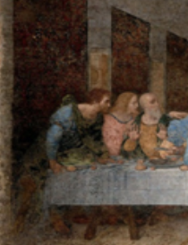
When Jesus reveals the betrayal,
Bartholomew, James, son of Alphaeus, and Andrew are surprised

Slide 3
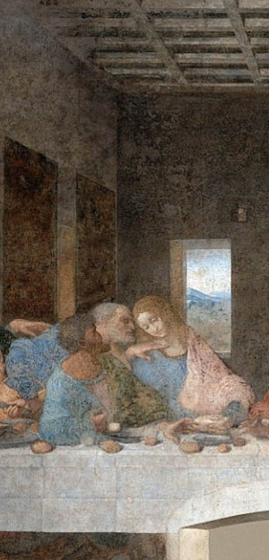
Judas Iscariot is wearing in green and blue, he is sort of off to the side. He is holding a small bag in his right hand. He is leaning with his arm on the table and he is reaching toward the same dish.
Peter looks angry and he is holding a knife.

Slide 4
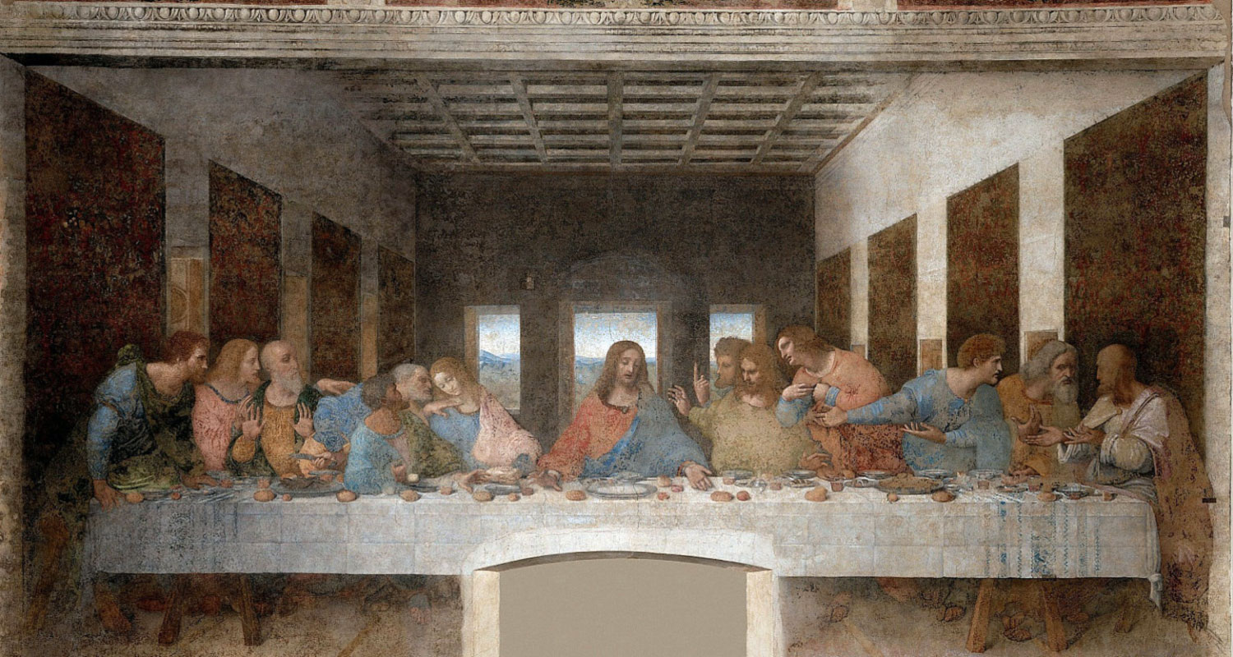
Jesus is in the centre. He is a reaching for a dish with his right hand.
Lighting and angles draw attention to Him. Jesus’s head is a vanishing point.
The painting contains several references to the number three (the Christian ideal of Holy Trinity), the Apostles are sitting in groups of three, there are three windows, Jesus’s shape resembles a triangle.

Slide 5
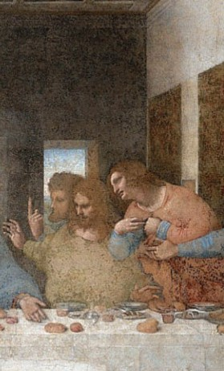
Thomas is upset,
James, the son of Zebedee, looks stunned with his arms in the air,
Philip is asking a sort of explanation

Slide 6
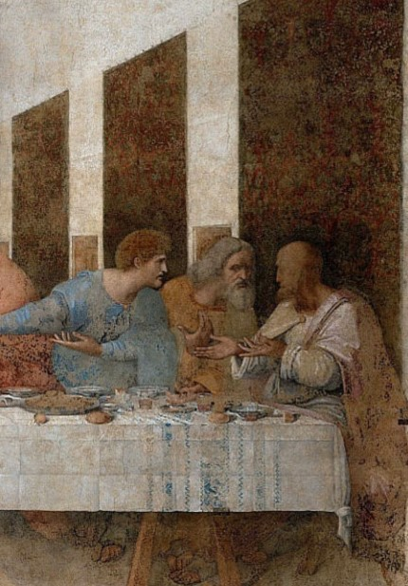
Matthew and
Jude Thaddeus are turning towards
Simon the Zealot, probably to listen to answers to their questions

